Slide 1
F.U.M.L.
(F.U.M.L. Uses Machine Learning)
Notes:
[Trevor]
Project Description
Team Members and Responsibilities
Problems you ran into during production and how you overcome them
Most of the time should be on demonstrating your project.
“Hello, my name’s Trevor Brooks, and welcome to F.U.M.L.’s Software Engineering Capstone Project, December 2021. F.U.M.L. stands for F.U.M.L Uses Machine Learning”

Slide 2


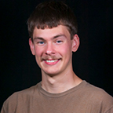
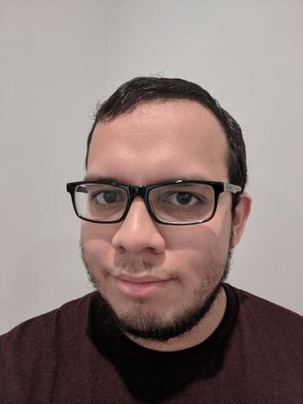
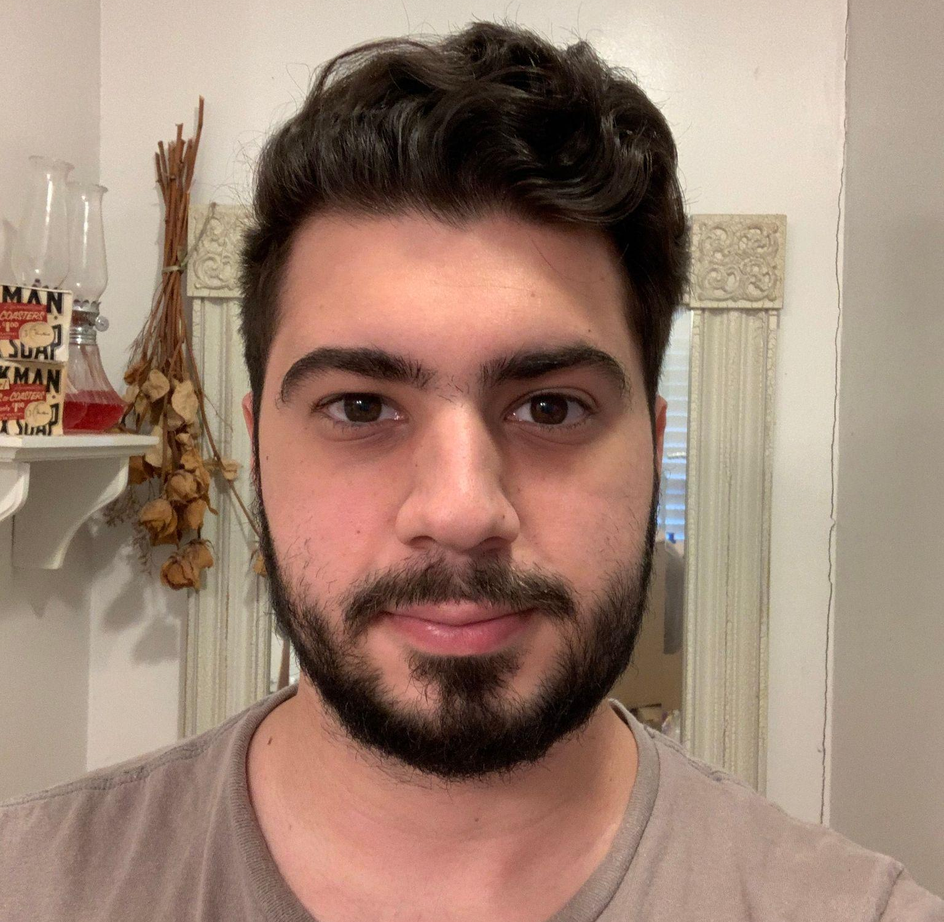
Meet the Team
Trevor Brooks
Michael Fulghum
Michael Goetz
Felix Potter
David de Sousa
Notes:
[Trevor]
Our team members are: Me, Trevor Brooks, Michael Fulghum, Michael Goetz, Felix Potter, and David de Sousa.

Slide 3
Team Responsibilities
Trevor Brooks - Research and Development, Deep Learning.
Michael Fulghum - Back-end Development, Algorithm.
Michael Goetz - Front-end Development, Python PDF library research.
Felix Potter - Front-end Development, HTML designer.
David de Sousa - Back-end/Middle-end Development, PDF Logic.
Notes:
[Trevor]
Each team member has different responsibilities.
I was responsible for research for the project and deep learning,
Michael Fulghum was responsible for Back-end development and working on the main algorithm,
Michael Goetz was responsible for Front-end development and researching proper python libraries,
Felix was responsible for Front-end development and the HTML for the website,
and David worked on the Back and Middle end development and helping with the PDFs.

Slide 4
Project Problem & Perspective
Existing automatic PDF tools to convert them into a fillable state with minimal user knowledge are sparse in the market and where they exist, they are either locked behind paywalls that drive away smaller users or output results that are inaccurate and/or hard to access.
For people who are less technologically inclined, our software seeks to alleviate their reliance on paper forms by enabling them access to an easy-to-use solution that is accurate and free.
Notes:
[Trevor]
Our program was designed to take in PDFs and automatically highlight fillable zones, like signature zones or checkboxes. This does already exist in some capacity, but are locked behind paywalls, and most do not accurately highlight the zones at all. We decided to create something that was simpler, free, and could be made to be used on enterprise scale.

Slide 5
Purpose
Create a web application that enables users to intuitively and easily create fillable forms
Improve current approaches to PDF field recognition and increase accuracy of output fillable forms
Make use of machine learning and shape/text recognition through a software package
Notes:
[Trevor]
We decided to work on making a project like this since we realized that the field that does it is not that mature, and we also wanted to make an open source alternative. We also investigated possible ways to implement machine learning.

Slide 6
Product Functions
Allow for a file as input of the specific file format PDF
PDFs of varying sizes and page formats should work just as well as more commonly used formats
Given a PDF, a fillable version should be provided as output in return
Users should be able to navigate the website and its pages without incident or irregularities
Users should be able to create and access their accounts on the website
If logged in, users should have the option to receive emails of their fillable PDFs that the software returns
Notes:
[Trevor]
Our product has many functions. The main function is to give the program a PDF, and it returns a fillable PDF with signature lines and checkboxes highlighted. There are also numerous options and settings that the website handles. Both of these groups of functions will be explained in further detail later.

Slide 7
Software Composition
The software is composed of two parts:
The back-end which handles the actual modification and return of downloaded files through PyPDF and a trained algorithm.
The front-end website, which handles user accounts, emails, and the uploading and downloading of files through Flask and SQL.
Notes:
[Trevor]
As stated earlier, we have two main components: The backend, that handles the PDF formatting, and the frontend, which implements a website through flask and sql libraries.

Slide 8
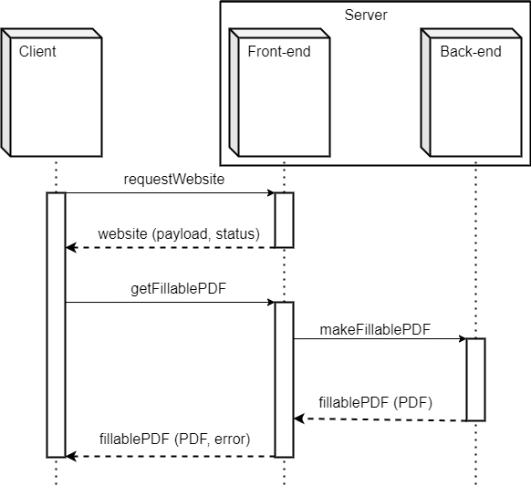
Core Usage Sequence
Notes:
[Trevor]
The diagram on screen is a basic diagram for our product. The user has two main functions, requestWebsite and getFillablePDF. The request website would be accessed whenever the url is sent, and the get Fillable PDF would be called when that main function is used. That request would be sent to their respective front end and back end, and would return their respective results, along with possible error reports if something goes wrong.

Slide 9





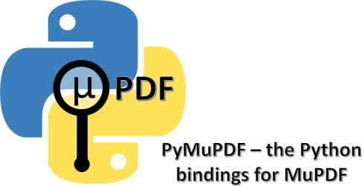

Our Tech Stack
NumPy
Notes:
[Trevor] When designing our project, we immediately went for python, since its accessibility and many libraries, like Numpy and PyMuPDF, were extremely helpful.

Slide 10
Back-end development
Purpose
To find fillable areas and checkboxes for each page in some PDF.
The algorithm
Used OpenCV to implement fillable region detection.
The pages of a PDF are converted to images.
Each image is processed through a series of transformations to detect patterns.
Unlikely fillable regions are then eliminated using intersection analysis.
Notes:
[Michael F] Hi my name is Michael Fulghum and I will discuss the algorithmic part of the back-end. The Back-end of our server is responsible for identifying the possibly electronically fillable areas of each page of the fed in PDF.
We used OpenCV, a a computer vision library, to implement a processing pipeline to accomplish this task. We then use algorithms to eliminate possible false positives.

Slide 11
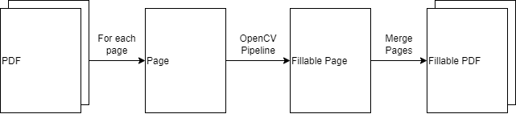
Back-end Pipeline
Notes:
[Michael F] Here is a summary of the processing pipeline. Notice how one page of the PDF is processed at a time. Each page is scaled to a standard size while keeping the aspect ratio; then, it is fed through the OpenCV Pipeline which we will cover in the next slide. After the OpenCV Pipeline, the fillable page is created. After all of the pages have been processed, they are merged to create a fillable PDF.

Slide 12
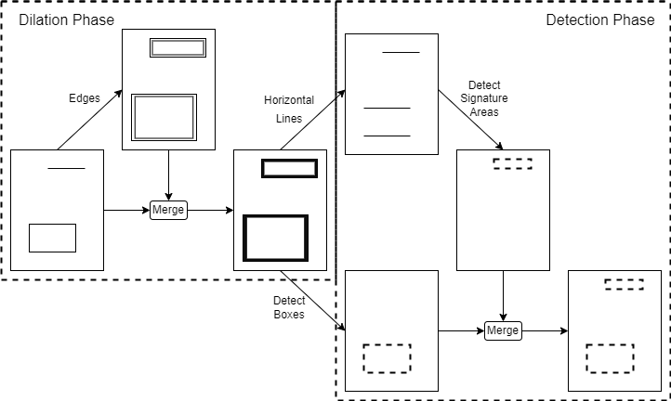
“OpenCV Pipeline”
Notes:
[Michael F] Here is what happens for a single page in the OpenCV Pipeline. The page is altered so that critical areas are amplified like edges: this is the dilation phase. Boxes and signature lines are detected and these mark the fillable areas of the page; these areas are then merged to create a fillable page: this is the detection phase.

Slide 13
PDF Generation Process (Post OpenCV)
Purpose
To use information from detection algorithm to then implement fillable elements to a PDF.
Algorithm
Fillable locations are received from the detection algorithm
They are filtered based on the type of fillable element they are
The PDF is then scaled to a position measurement used by Reportlab
Fillable elements are then populated page by page
Notes:
[David D.] From the detection phase we arrive at the PDF Generation phase, where the information that was outputted from OpenCV pipeline is actually utilized in order implement the fillable elements onto the PDF. They’re then filtered into their different types, whether it be a text field or a checkbox, and from there their positions on the page are scaled to the units used by the library and finally integrated into the document. This is done page by page until the entirety of the PDF has been processed, and the final product is then outputted to wherever it needs to go.

Slide 14
Problems in Back-end Development
Could not find a suitable machine learning framework.
Assumed some technical debt and went with computer vision techniques.
How to handle signature boxes, checkboxes, closed textboxes, etc.
Identify different graphical features. Eliminate false positives using algorithm.
How to create PDF after fillable regions are detected.
Overlay new fillable regions over the original pages: no need to re-render PDF or depend on page sizes.
Notes:
[Michael F] We did encounter a few issues in the development of the back-end. The first one was that we could not find an applicable and usable machine learning framework; so instead, we went with OpenCV to implement computer vision techniques. Another issue was how to handle different types of fillable regions, so our algorithm recognizes different graphical features to find these regions. Our last significant issue was how to handle PDF creation and modification after the fillable regions have been detected; thankfully, we discovered a library which performs well at doing exactly that.

Slide 15
Problems in Back-end Development cont.
Limited resources for PDF modification
Laborious search for library which modified an existing PDF document
End result is a combination of two different libraries working in tandem
Different sizing units between library and detection algorithm
The modifier library used its own sizing units vs the detection algorithm which outputted pixel positions.
Notes:
[David D.] Speaking of that library, it wasn’t exactly easy to find. It was quite the search to find a library that actually modified an existing PDF rather than create a new one. In fact, I never really did, instead I used 2 different libraries, one which creates a PDF which fillable elements, and another which is able to merge 2 existing PDF’s. And with that we gained the functionality of editing an existing PDF, but with a few extra steps. In addition to that I also had a small issue of unit conversion. This was due to the fact that the reportlab library uses it’s own sizing units in contrast to the units used by the OpenCV pipeline, which was just the size of the PDF in pixels. So that also took quite a bit to figure out how I wanted to approach it.

Slide 16
Front-end development
Purpose
To create a user-friendly website that enables user to immediately be able to upload PDFs and download fillable PDFs, as well as create and sign into secure accounts that allow users to receive emails of their finished PDFs
The website
Follows a pattern similar to many existing websites for familiarity and accessibility
Based on Flask and uses SQL to store database of accounts
Accounts are encrypted using AES and only password hashes are stored
Notes:
Michael G
The web app acts as the user interface for the software and is intended to be intuitive and easy to use. The homepage of the site is the upload page, our most important feature. A 10 MB upload size limit protects against overload and potential crashing. The account system only stores encrypted user information and starts with an opt-out for the email option in the pursuit of user-friendliness.

Slide 17
Problems in Front-end development
Size limitation and downloading of the returned file arose as problems for the result page
Use of app.config and redirect() function to open a new page for download
Issues of missing proper requests, throwing errors to end users
Proper implementation of POST and GET request to communicate with website
HTML hiccups, such as improper links and incorrect design for elements
Thorough review of HTML code through user simulation testing
Notes:
[Michael G.]
The front-end development followed an incremental approach where single features were implemented and tested at a time in order of priority where possible.
First and foremost was the uploading and downloading of files in the website’s most basic iteration. Correct size limitation was possible through app.config() and the redirect function allowed for the creation of a new window so a user could choose to download a file more than once while on the same page.
Next was the improper requests resulting in Flask errors thrown on the user’s end. This was remedied through proper use of POST and GET functions for the pages.
Finally was the various HTML errors that appeared during development, whether they be an incorrectly marked element like the about page being highlighted when the user is in the login page or button sizing. Reviewing the HTML files and using the HTML documentation for modifying elements fixed these.

Slide 18
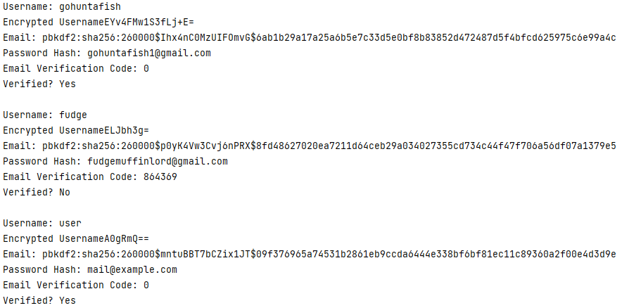
SQL Demonstration
Notes:
Michael G.
This is a print out of our SQL database table after we added our new user. It is how our program stores account information. The first two are default users for testing purposes. Starting with the first user, we have the unencrypted username, the encrypted username, which is what is stored in the database, the password hash, which is the hash of the encrypted password, the email, which is encrypted in storage, the email verification code, and the check for whether a user is verified. You may notice that gohuntafish and user both have 0’s for their email codes, and that is because the program sets them to 0 once they are verified.

